Slide 1
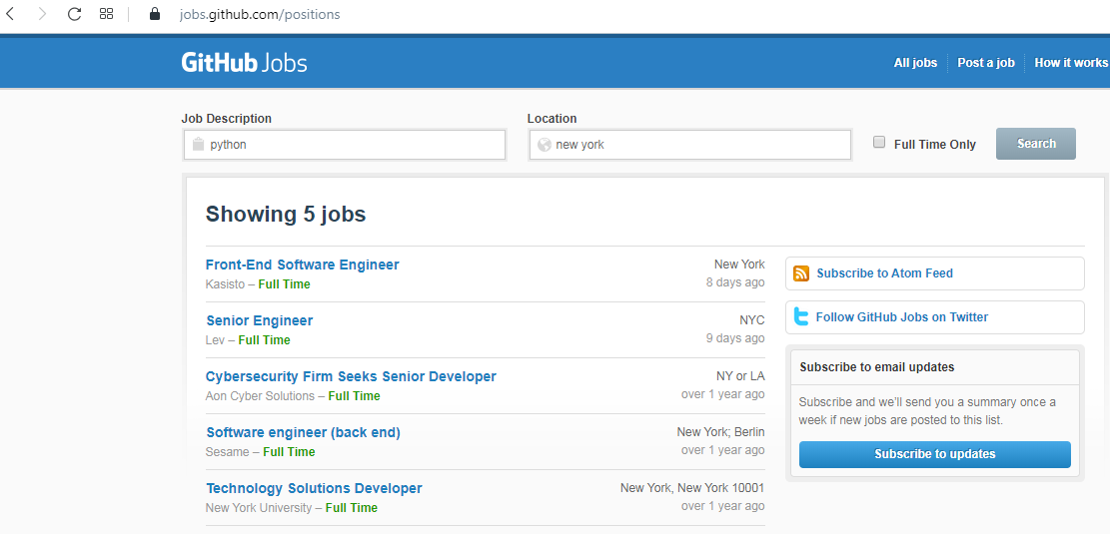


Why do we need HTTP?
Client
Request
Response
Using HTTP Protocol Client send information from client to server.

Slide 2
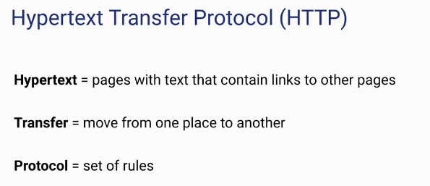
Why do we need HTTP?
The internet cannot work without HTTP
APIs use HTTP

Slide 3
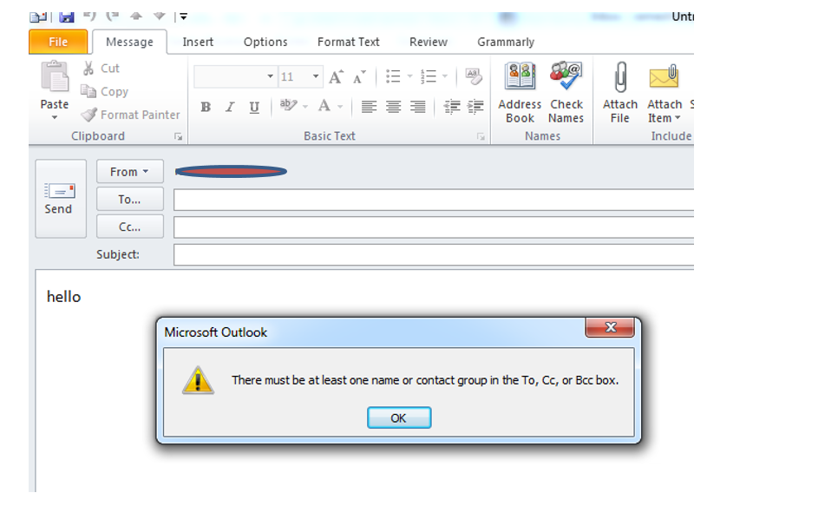
Why do we need HTTP?

Slide 4
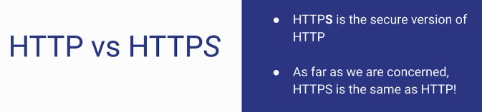
Why do we need HTTP?

Slide 5

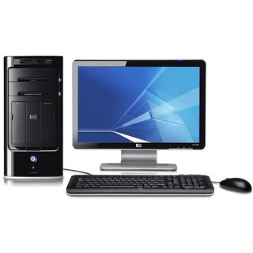



Why do we need HTTP?
Encrypted Message
Server
Client
Encrypted Message
Encrypted Message

